Slide 1
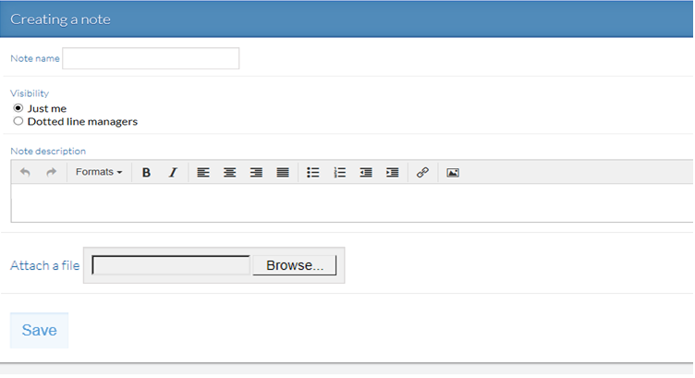
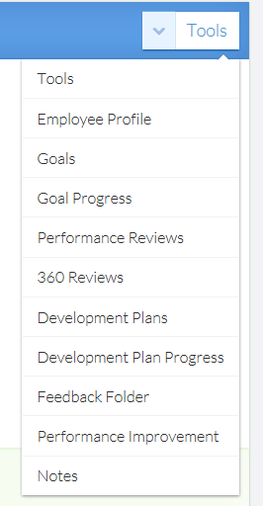
Notes – Create and View
Step 1-To create or manage notes for reporting staff, select the leader tab and mange the individual staff via notes on the tool dropdown menu.
Step 2
Step 2 – Select add a new note
Step 3 – Name the note
Step 4 - Select visibility
Step 5 - Complete details
Step 6 - Attach support if desired
Step 7 - SAVE
Step 3
Step 4
Step 5
Tip: Notes are private to you only or dotted line managers may be included.
Step 6
Step 1
Step 7

Slide 2
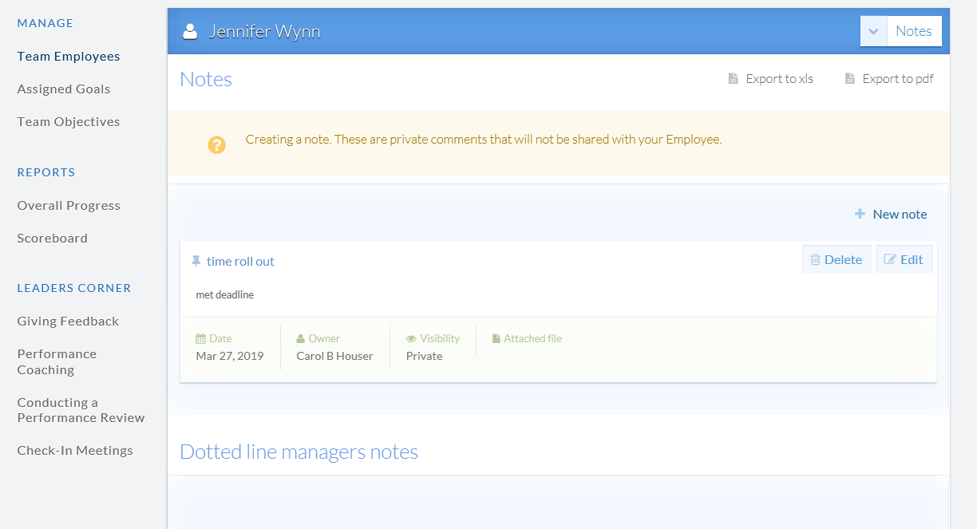
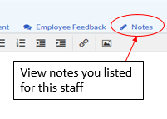
Notes – Create and View
Notes may be viewed from the tool dropdown menu when you “Manage” staff or as shown below from within the review for convenience. Notes are helpful to add throughout the year to document items for the performance review.
Tip: Should there be a dotted line manager, their notes will appear on the staff notes page.

